Slide 1
Elliptical agents for collision avoidance

Slide 2
Motion Planning
Independent agent
Agent goals
Each agent should reach their goal

Slide 3
Motion Planning
Centralized planning
The entire set of possible configurations are considered
A global plan is picked for all the agents at once
Pre-computation time too high

Slide 4
Motion Planning
Decentralized Planning
Global planning
An independent path for each agent is computed
Only static obstacles are considered
Local planning
Avoid dynamic and moving obstacles while simulation
Different methods to keep moving agents from colliding

Slide 5
Decentralized planning
Global planning
Figure out free navigable space in the scene
Find the optimal path in the free space
RoadMaps, Navigation meshes, Potential field for navigation space
Dijkstras algorithm, A* search
Provides preferred velocity V_{p}

Slide 6
Local Planning
Collision free optimal velocity based on preferred velocity
Computationally less expensive
Each agent needs to know only surrounding information
Social Forces, Velocity obstacles, Reciprocal velocity obstacles, ORCA, and EORCA
Narang, S. et al. [2017]; Best, A et al. [2016]; van den Berg J [2011]; Narain R et al[2009]; Helbing D et al. [1995]; Fiorini, Paolo et al. [1998]

Slide 7
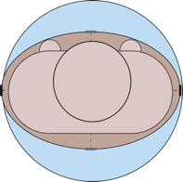
Agent shape
Agents are shaped as disks
Geometric computations are inexpensive
More than actual required space
Orientation is not intrinsic

Slide 8
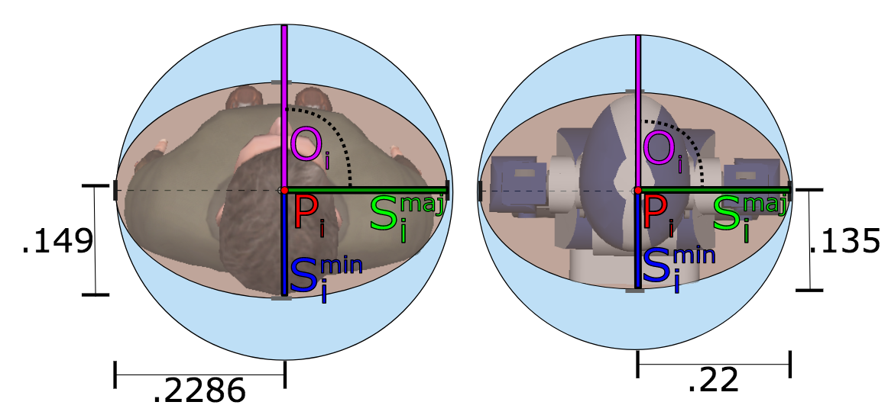
Elliptical Agents[Best A. et al. 2016]
Agents are modeled as ellipses
Orientation is intrinsic
More agents in a given space
Shoulder turning, side stepping, back peddling

Slide 9
Agent Space
Disk - Agent state : [P, V_{p}, V_{o}]
P: agent position
V_{p}: Global velocity
V_{o}: Local planner velocity
Ellipse - Agent state: [P, V_{p}, V_{o}, O_{p}, O_{o}, S_{min}, S_{max}]
O_{p}: Current Orientation
O_{o}: Changed orientation

Slide 10
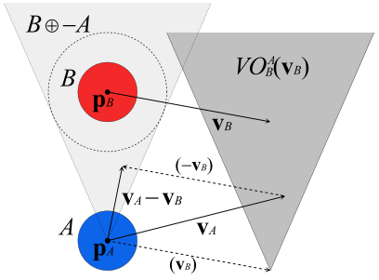
Velocity Obstacles[Fiorini et al. 1998]
Compute the set of velocities that lead to collision
Each agent tries to avoid that set of velocities
VO, RVO, ORCA, EORCA

Slide 11
Velocity obstacle
${VO}_{X|Y}^{τ}$: Set of velocities for X that would result in a collision with Y
M: Minkowski sum of the space occupied by the agents
In RVO each agent takes half the responsibility to avoid collisions

Slide 12
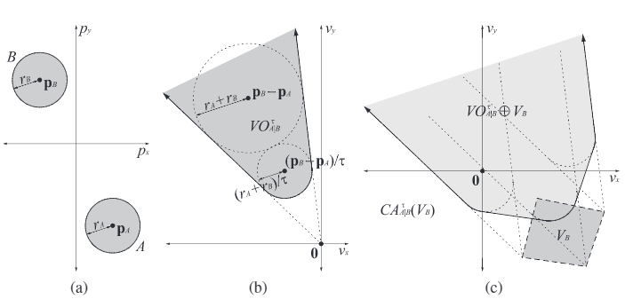
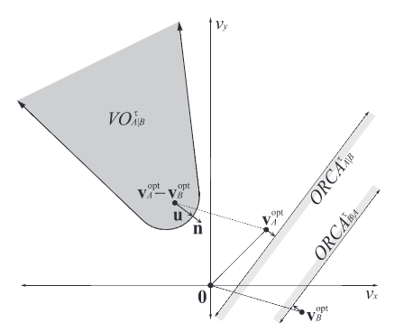
Velocity Obstacles
${ORCA}_{A}^{τ}= \bigcap_{B≠A}{{ORCA}_{A|B}^{τ}}$
$v_{A}^{new}=arg \min_{v∈{ORCA}_{A}^{τ}} \left||v − v_{A}^{pref}|\right|$

Slide 13
Velocity Obstacles (Disks vs. Ellipse)
Computation of Minkowski sum (MS) is important for VO
MS for disks is straightforward
MS for ellipses is computationally expensive

Slide 14
EORCA Collision Avoidance
Compute neighbor agents constraints
Compute neighbor obstacle constraints
Find collision-free velocity

Slide 15
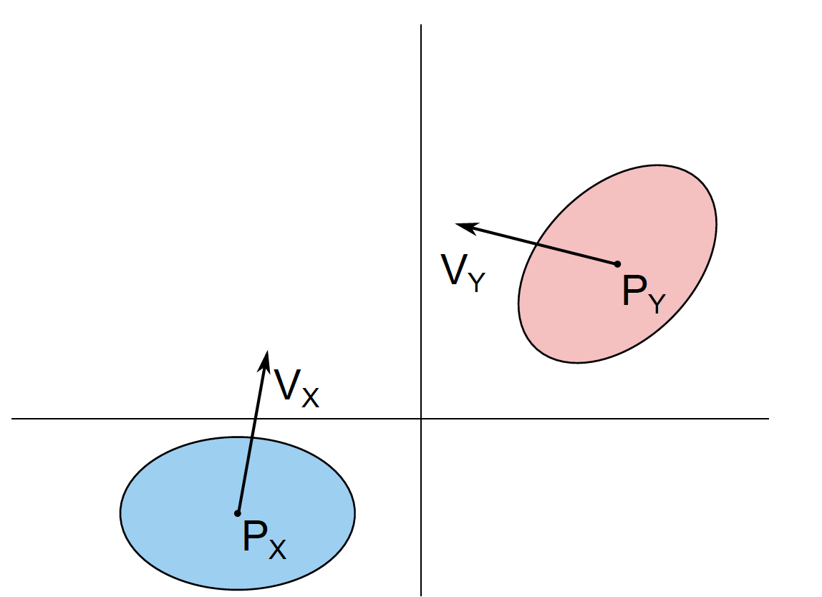
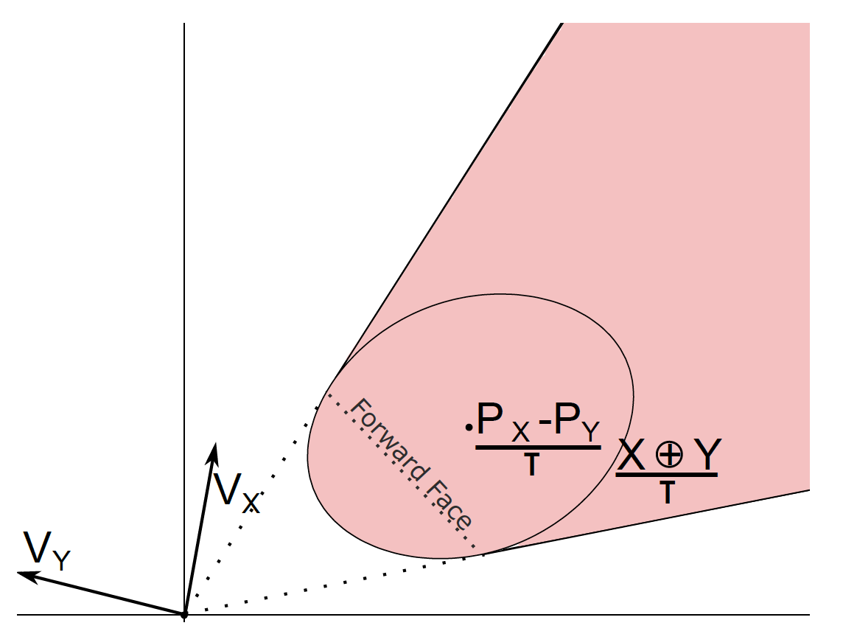
Neighbor agents
Velocity obstacles for elliptical agents
The velocity obstacle for X induced by Y takes the shape of a truncated cone
The forward arc of the cone is the forward face of the Minkowski Sum of -X and Y scaled by and centered (P_{x} – P_{y} / T)

Slide 16
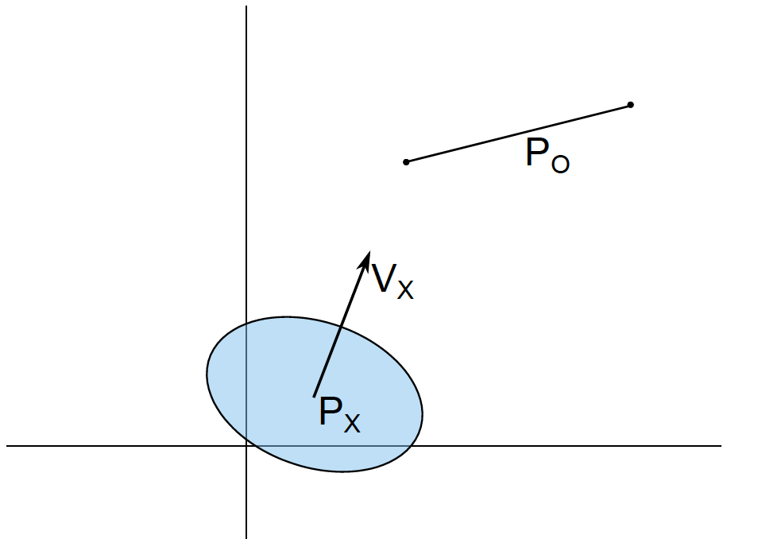
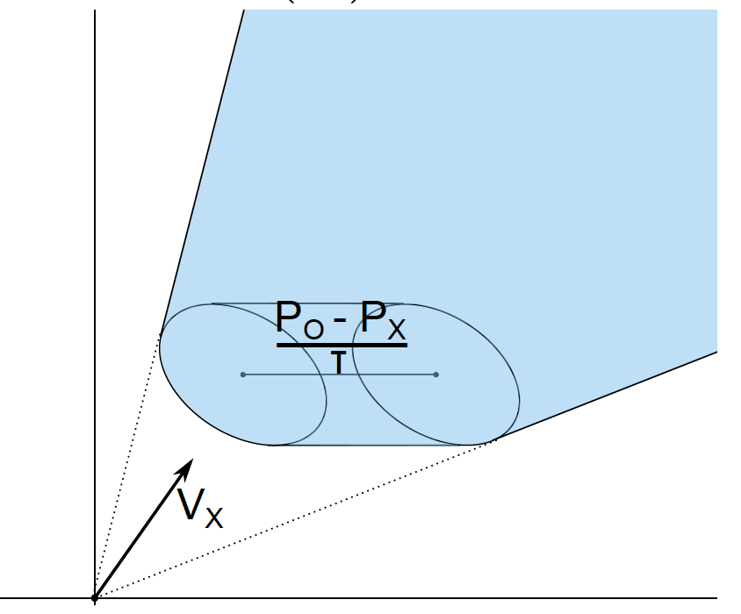
Neighbor Obstacles
Obstacles are represented as lines
An agent moves toward a line segment obstacle
Forward arc of the cone is the forward face of the Minkowski Sum of 􀀀X and O scaled by and centered at (P_{o}– P_{x} / T)

Slide 17
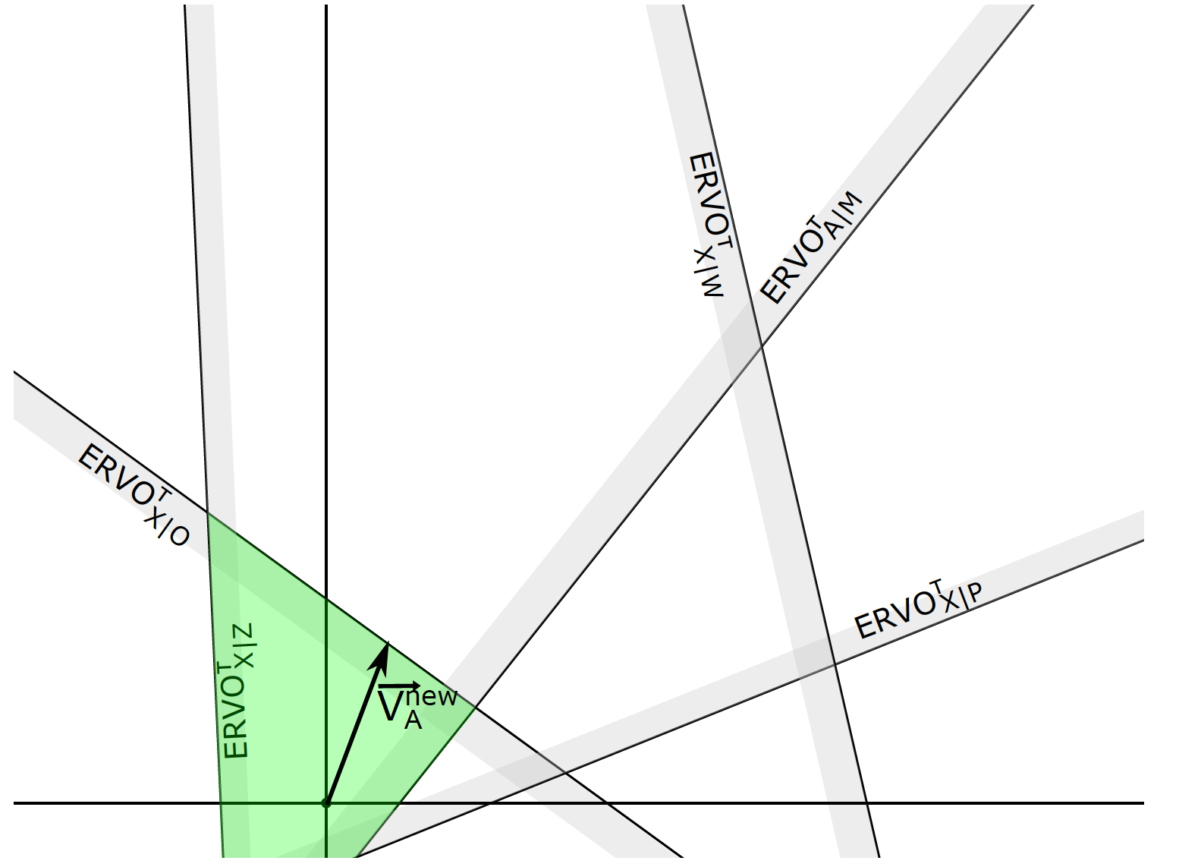
Compute collision free velocity
Compute all the constraints
New velocity is chosen from the region of feasible velocities
${ EORCA}_{A}^{τ}= \bigcap_{B≠A}{{EORCA}_{A|B}^{τ}}$
$v_{A}^{new}=arg \min_{v∉{EORCA}_{A}^{τ}} \left||v − v_{A}^{pref}|\right|$
Linear programming is used to compute $v_{A}^{new}$

Slide 18
Ellipse approximation[Best A et al. 2016; Narang S et al. 2017 ]
Piecewise linear approximation
Sample points along the ellipse at regular interval
Polygon enclosed by the tangents at those points

Slide 19
MS precomputation
MS is precomputed and stored for approximated ellipses
Rotate the ellipses with small angle to get surface set K
Compute MS between all pairs of ellipses in K

Slide 20
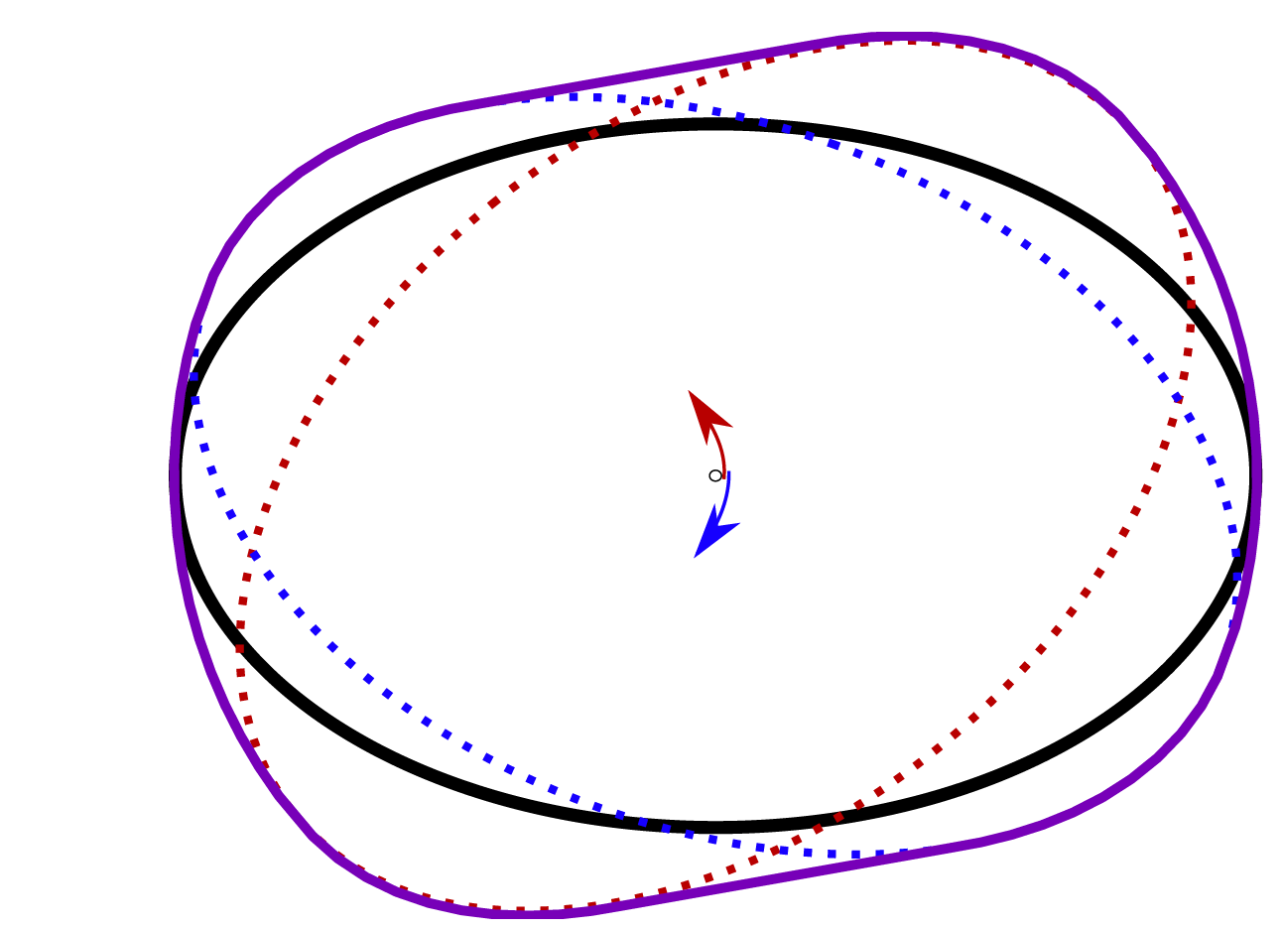
Sweep surfaces
To speed up orientation updates
Ellipses are rotated in both directions
The swept volumes generated is K``
MS is computed for all the pair of surfaces in K & K``

Slide 21
Orientation Update
$v_{A}^{new}=arg \min_{v∉{EORCA}_{A}^{τ}} \left||v − v_{A}^{pref}|\right|$
There are cases when no solution exists for $v_{A}^{new}$
Such cases VO, RVO, ORCA sets $v_{A}^{new}$ to zero velocity
EORCA can use the the orientation change to find new feasible velocities

Slide 22
Orientation Update
EORCA – O:
If solution exists for $v_{A}^{new}$ no need for orientation update
EORCA – F:
Update the orientation when $v_{A}^{new}$ has no solution

Slide 23
EORCA - F
Case when the agent cannot find feasible $v_{A}^{new}$
Compute the clearance available for new orientation
Update the agents to the new orientation

Slide 24
Natural human movements [Hughes et al. 2014]
Shoulder Turning
Back Peddling
Side Stepping

Slide 25
Natural human movements [Hughes 2014]
Sweep surfaces is a conservative approach
Agents try to keep a large safe distance away
Due to bigger surface in the swept volumes generated is K``

Slide 26
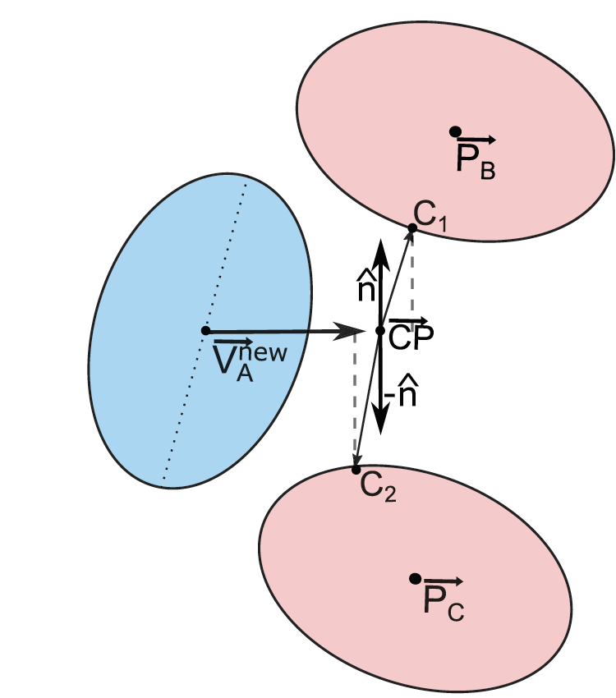
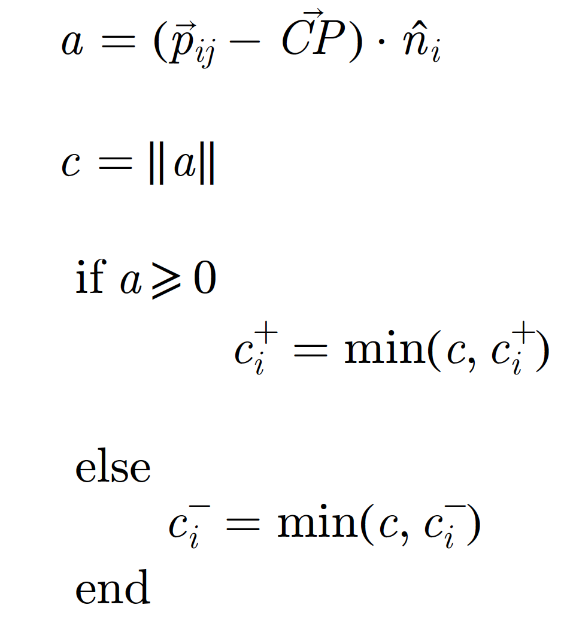
Shoulder Turning
First compute the clearance $C$ available for the agent
$o_{}^{new}=arg \min_{o_{}^{new}}\left||o − o_{}^{new}|\right|$ $w(o_{}^{new})≤C_{}^{}$
Total Clearance $C_{}^{}=C_{}^{+}+C_{}^{−}$

Slide 27
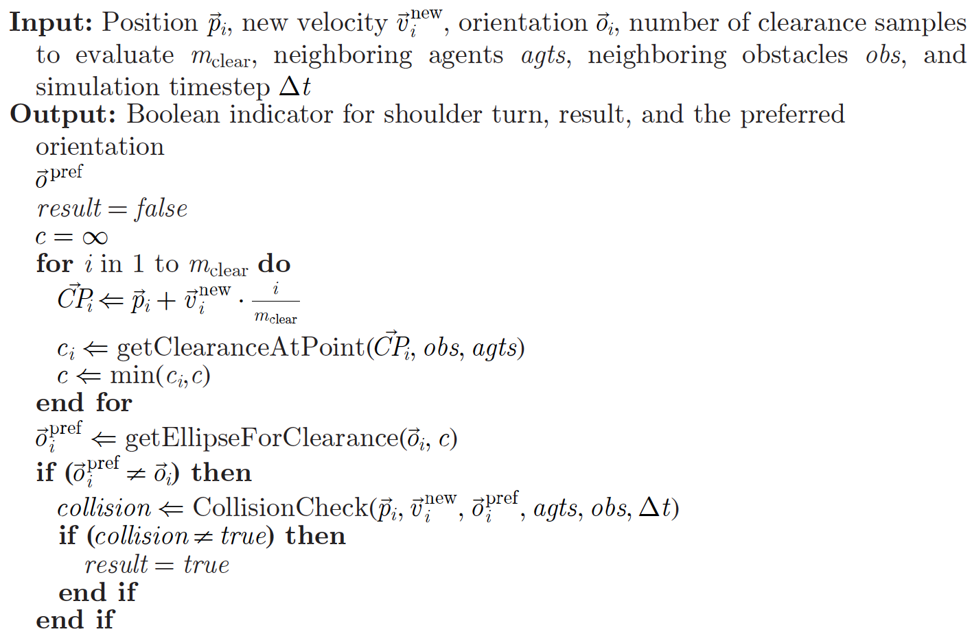
Shoulder Turning – Algorithm

Slide 28
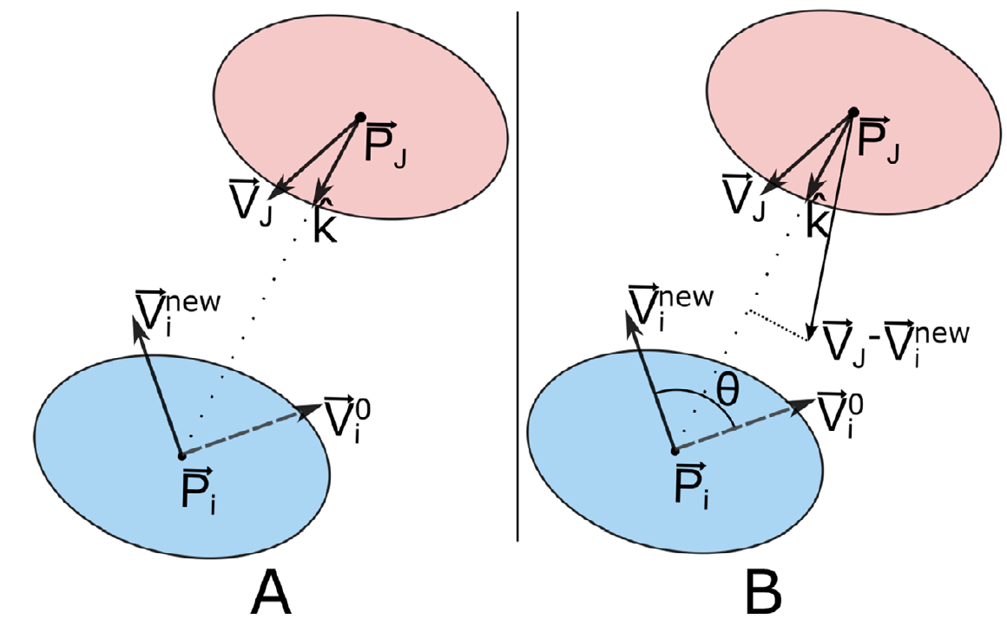
Lateral movement (cite henry)
$v_{jk}^{tang}$ computed projecting onto the displacement direction $k_{}^{}$
Two conditions :
Deviation between $v_{i}^{new}$ and $v_{i}^{o}$ is greater than $θ_{thresh}^{}$
Time to collision is less than ${ttc}_{thresh}^{}$

Slide 29
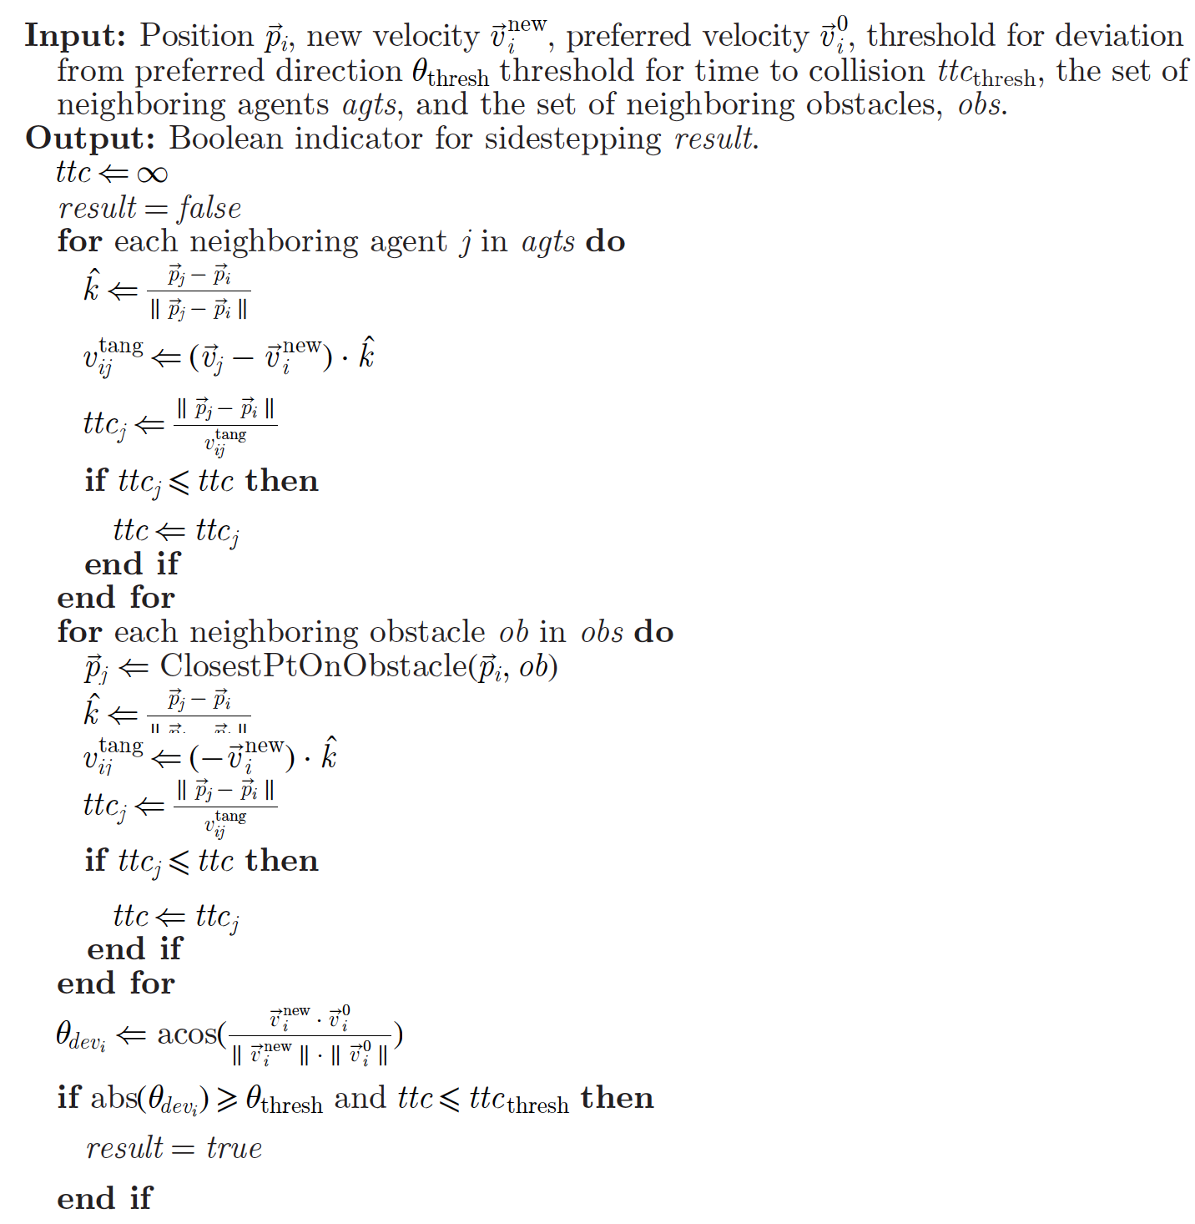
Lateral Movement Algorithm

Slide 30
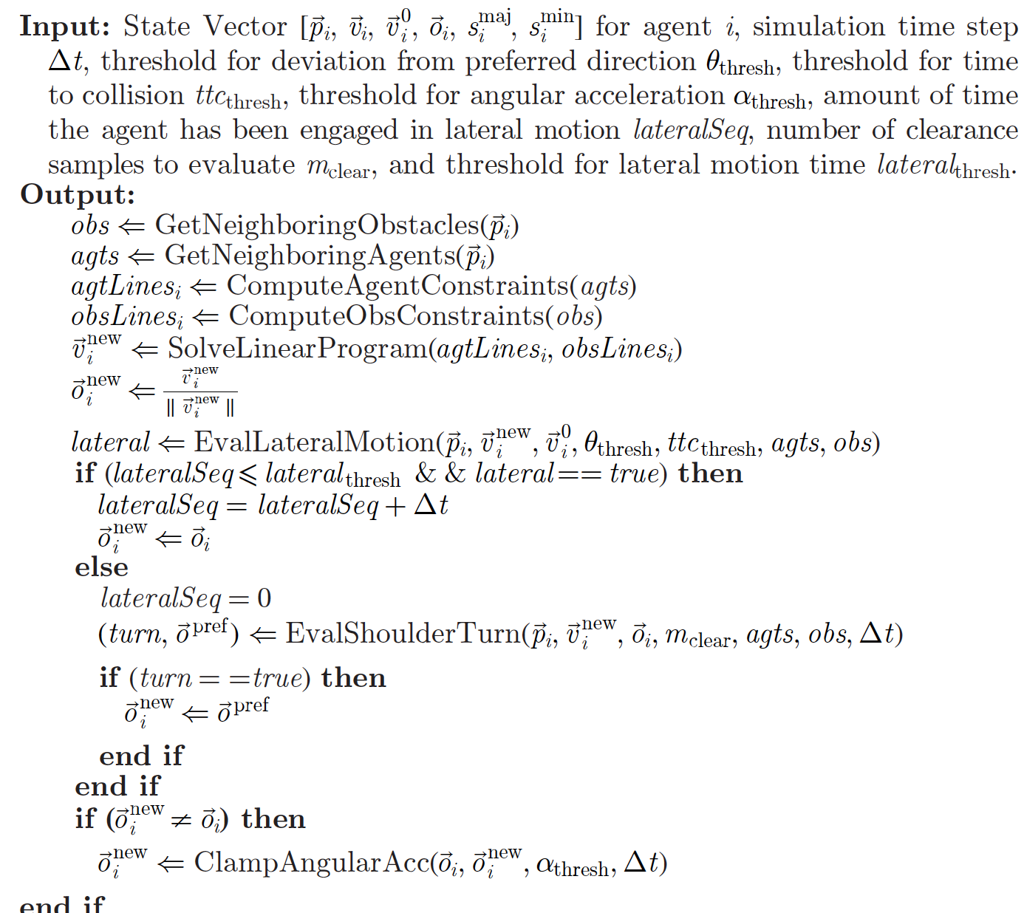
Overall Algorithm

Slide 31
Demo - 1

Slide 32
Demo - 2

Slide 33
References
Narang, S., Best, A., & Manocha, D. (2017). Interactive simulation of local interactions in dense crowds using elliptical agents. Journal of Statistical Mechanics: Theory and Experiment, Volume 3, 2017.
Best, A., Narang, S., & Manocha, D. (2016). Real-time Reciprocal Collision Avoidance with Elliptical Agents. In IEEE International Conference on Robotics and Automation (ICRA) pp. 298-305. IEEE, 2016. Hughes R, Ondrej J and Dingliana J 2014
Holonomic collision avoidance for virtual crowds Symposium on Computer Animation ed V Koltun and E Sifakis (Goslar: Eurographics Association) pp 103–11
van den Berg J, Guy S J, Lin M and Manocha D 2011 Reciprocal n-body collision avoidance Int. Symp. On Robotics Research pp 3–19
Narain R, Golas A, Curtis S and Lin M C 2009 ACM Trans. Graph. 28 122:1–8
Helbing D and Molnár P 1995 Phys. Rev. E 51 4282–6
Fiorini, Paolo, and Zvi Shiller. "Motion planning in dynamic environments using velocity obstacles." The International Journal of Robotics Research 17.7 (1998): 760-772.

Slide 34
The End

Slide 35
Narang, S. et al. [2017]; Best, A et al. [2016]; van den Berg J [2011]; Narain R et al[2009]; Helbing D et al. [1995]; Fiorini, Paolo et al. [1998]

Slide 36
Contents
Planning, there are agents and there are goals
Centralized planning and decentralized planning
Decentralized planning is Global planning and dynamic local planning
Centralized planning is plan before start by exploring all possible states and picks the best one
Global planning is easy we have seen it in class
Local planning we have seen some cite papers method
Today, I’ll discuss EORCA in detail
Why EORCA is better density, orientation is embedded. Natural human motions and maneuvers can be modeled straightforward
Rewind to Velocity obstacles, each agent takes half responsibility
What are Minkowski sums?? What do they geometrically represent?

Slide 37
Calculating Minkowski sum for ellipses analytically is hard. So sample points.
Pre-compute tables for all possible orientations and show sweep surfaces
Construct the half planes and find the solution as we do in velocity obstacle.
Now sometimes you do not get a solution in that case. Then check for orientation change and use pre-compute sweep surfaces
Advantages and methods for doing it.
Sahil papers algorithms; computing clearance, then use it for orientation; Compute the theta and lateral movement if possible.
Show videos

Slide 38
Orientation change – No solution

Slide 39
Decentralized Planning
Two parts:
Global planner generates an optimal path and preferred velocity
Local planning
Social forces, Helbing, and others and cite other papers

Slide 40
Velocity obstacle
Definition
Figure

Slide 41
Topics list
Introduction
One of the main issues in multi-robot planning and multiagent navigation is computing collision-free paths for each robot or agent from its start position to its goal position. This problem arises not only in robotics and AI, but also in computer games, virtual environments, pedestrian dynamics, and simulations of collective behaviors in biology.
most of these decentralized algorithms represent each agent as a circle in a 2D plane
Motivation

